Slide 1
Is what UK voters believe is important reported in national newspapers? An analysis of UK voter priorities compared to newspaper coverage in the run up to UK general elections.

Slide 2
Project Overview
Objective: To analyse and compare voter priorities with newspaper coverage leading up to national elections in the UK for the years 2010, 2015 and 2017.
Data Sources: YouGov, Poldem media datasets.
Tools Used: Python, Flask, SQLite, D3.js, Wordcloud, Apex

Slide 3
Data Sources
YouGov Data – YouGov do regular surveys where the question asked was “Which of the following do you think are the most important issues facing the country at this time? Please tick up to three” – and a list of options given e.g. the economy, education etc.
These surveys have been done since February 2011 every week excluding public holiday weeks

Slide 4
Data Sources
Poldem Data - The Observatory for Political Conflict and Democracy (PolDem) is a platform that produces and houses data on protest events, election campaigns, and issue-specific public contestation covering a wide-range of European countries over a long period of time.
For our purposes, it has collected data from 1970 to 2017 in some countries where it logs the issues that newspapers are reporting.

Slide 5
Ethical Considerations
All YouGov data was anonymized at source.
Whilst the Poldem data did have reference to specific individuals e.g. a certain politician raising a specific issue, this was kept in to retain context. We did try and build a dictionary that would filter out any names and just show the issues only – but we cannot guarantee with the time constraints that there are any that will slip through.
GDPR was followed at all times.

Slide 6
What data are we using?
YouGov: Date, and the percentage of respondants who said an issue was important e.g. on 15/1/2013, 53% identified “Health” as important. This was broken down further by factors such as age, political party supported etc.
Poldem: Date, and what topic was covered.

Slide 7
Data Cleaning
YouGov: Required significant re – arrangement to allow data import into the database. Files had to be transposed, re –edited etc. For example each csv had to be downloaded, transposed, column headers changed and the percentage sign removed before import.
Vbs was used to make an initial clean of the YouGov Data.
Poldem Data Cleaning: Removing noise, filtering relevant articles, and preparing text for analysis.

Slide 8
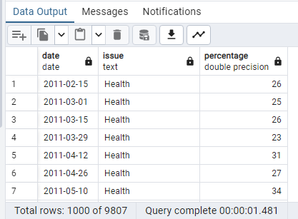
Data Storage
All data was imported into a database in pgAdmin successfully.

Slide 9
YouGov Data Analysis
Voter Priorities: Key issues identified by voters in each election year.
Visualization: Shown in Line Charts

Slide 10
Media Coverage Analysis
Media Topics: Most discussed topics in media articles.
Method: Using word frequency analysis to identify key topics.
Visualization: Shown in the Word Cloud

Slide 11
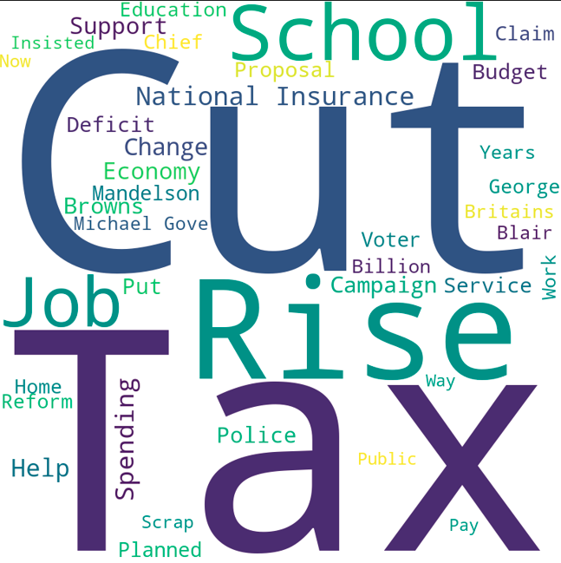
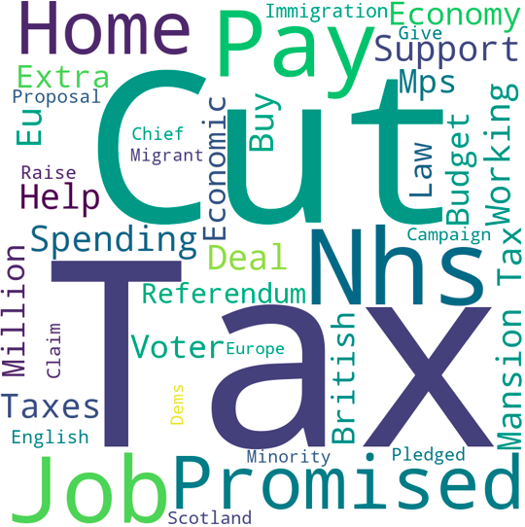
Visualisation – 2010 and 2015. .

Slide 12
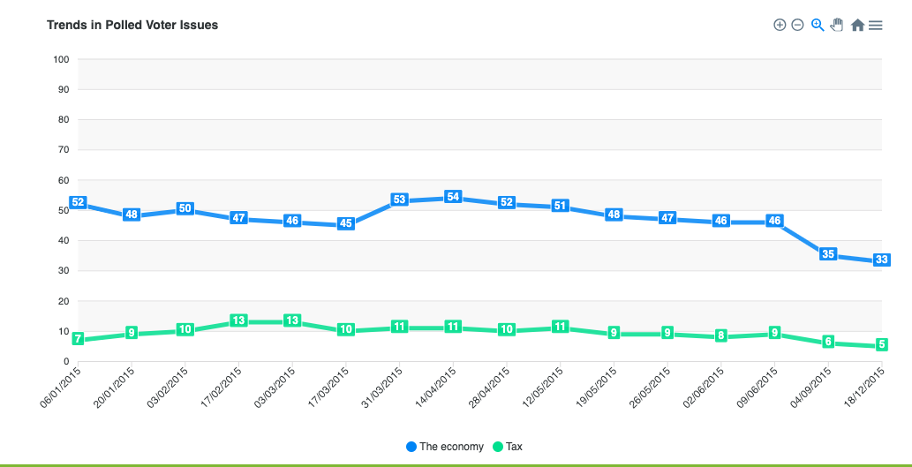
Visualisation 2 –Economy (Blue) and Tax (Green) in 2010.

Slide 13
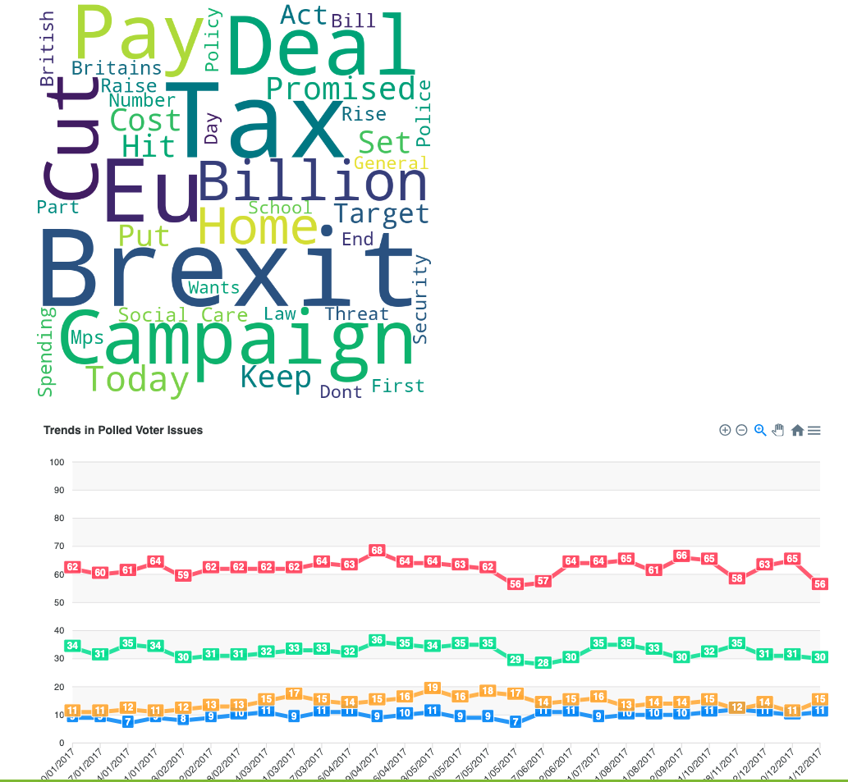
Visualisation 3 – 4 issues 2017.

Slide 14
Interactive Demo Time.

Slide 15
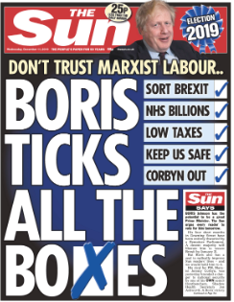
Conclusions and Insights
In the loosest sense, it does seem that what matters to the electorate does have an effect on what is reported in newspapers.
Context and nuances are crucial.
To what extent do newpapers guide as opposed to reflect the opinions of their readerships?

Slide 16
Considerations and future work
This is scaleable if we had data from 2017 onwards. Coding is still relevant for later time periods.
We have only used one source for newspaper articles – would a different source come up with e.g. different categorisations?
We only considered UK national elections. Would e.g. regional elections, other countries give the same conclusions?
We did try to include demographic information – but the timescale was against us.
The rise of online media has meant that print media circulation is falling – could something similar be done for online articles?

Slide 17
Questions?

